Slide 1

IMDB MOVIE REVIEW
PRESENTED BY:
S.JOGI NAIDU A.PAVAN
K.M.S.CHARAN B.ROHITH
M.VARUN KUMAR(TL) A.GANGADHAR

Slide 2
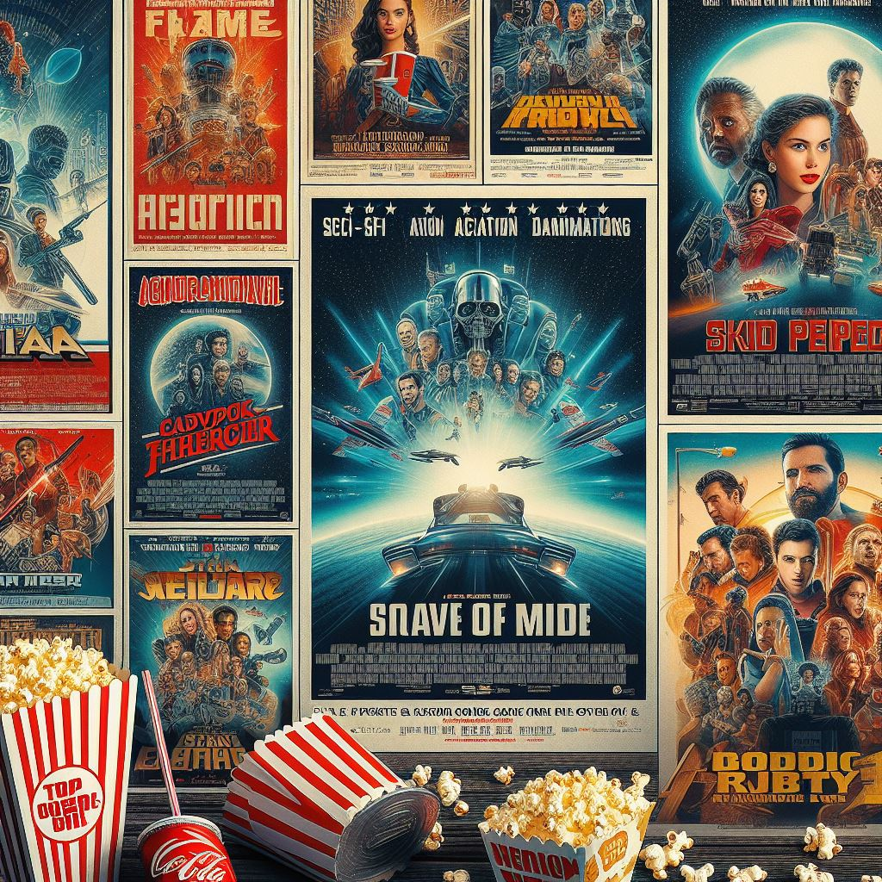
Agenda
INTRODUCTION
Problem Statement
Proposed System/Solution
System Development Approach
Algorithm & Deployment
Result
Conclusion
Future Scope
References

Slide 3

Introduction
IMDb stands for "Internet Movie Database."
It is an online database of information related to films, television programs, video games, and streaming content.
IMDb provides details about movies, TV shows, actors, directors, producers, and other industry professionals. Users can access a vast amount of information, including cast and crew lists, release dates, trivia, user ratings, and reviews.
IMDb is widely used as a reference source for film and television-related information.
IMDb uses AI for personalized recommendations, content tagging, search, moderation, insights, and user interaction.

Slide 4
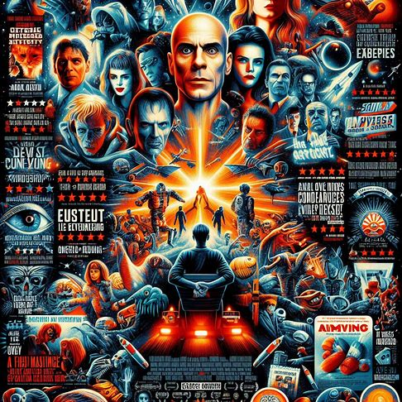
PROBLEM STATEMENT:
IMDB Movie Reviews✅Movie dataset for binary sentiment classification containing substantially more data than previous benchmark datasets. We provide a set of 25,000 highly polar movie reviews for training and 25,000 for testing.
So, predict the number of positive and negative reviews using either classification or deep learning algorithms.

Slide 5
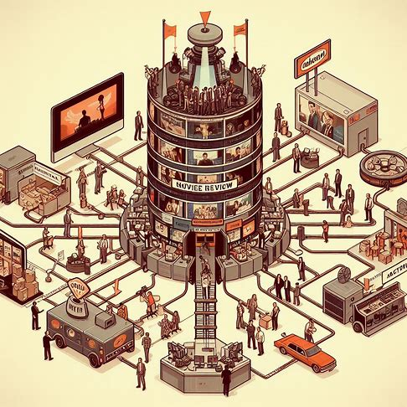
PROPOSED SYSTEM/SOLUTION:
Improvements to an IMDb movie review predictor include advanced text preprocessing, experimenting with diverse model architectures like transformers, ensemble methods, hyperparameter optimization, handling class imbalance, regularization, attention mechanisms, transfer learning, interpretability, advanced evaluation metrics, and user feedback integration for enhancement.

Slide 6
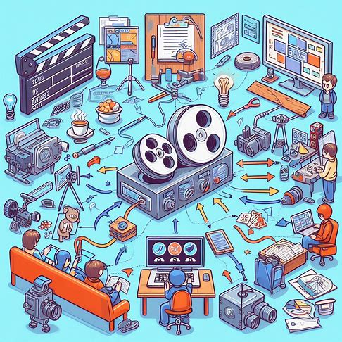
SYSTEM DEVELOPMENT APPROACH:
Enhance text preprocessing for better data quality.
Explore diverse model architectures like transformers.
Utilize ensemble methods for improved predictions.
Optimize hyperparameters for enhanced performance.
Address class imbalance for unbiased results.
Apply regularization techniques to prevent overfitting.
Incorporate attention mechanisms for better focus.
Leverage transfer learning for knowledge transfer.

Slide 7
ALGORITHM AND DEVELOPMENT
DEVELOPMENT:
Iteratively improving the model involves experimenting with different architectures and hyperparameters, incorporating techniques like data augmentation and ensemble methods for enhanced predictions. Deploying the model involves using frameworks like Flask or FastAPI and establishing monitoring for ongoing maintenance and improvement.
ALGORITHM:
Preprocess text data by removing noise, tokenizing, and vectorizing.
Choose a suitable model (e.g., LSTM, BERT) and architecture.
Train the model using IMDb movie review data.
Optimize hyperparameters using techniques like grid search or random search.
Evaluate the model using metrics like accuracy, precision, recall, and F1-score.
Implement ensemble methods if necessary for improved performance.
Fine-tune the model using user feedback and continuous monitoring.

Slide 8
RESULT
For the IMDb movie review predictor model, achieving improved accuracy, robustness, and generalization through iterative experimentation with diverse architectures, hyperparameters, and techniques ensures reliable predictions.
Continuous monitoring and refinement post-deployment maintain its effectiveness in providing accurate movie review sentiment analysis.

Slide 9
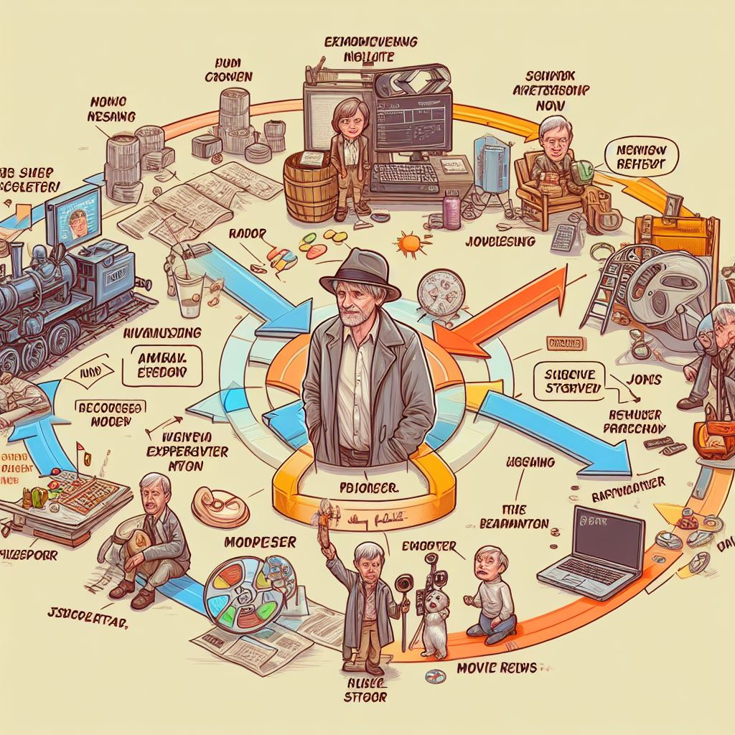
Conclusion
In conclusion, enhancing the IMDb movie review predictor involves a comprehensive approach of data preprocessing, model selection, training, and evaluation. By iteratively experimenting with various techniques and continuously monitoring the model's performance, we can ensure accurate and reliable predictions for sentiment analysis of movie reviews.

Slide 10
FUTURE SCOPE:
Improved Understanding: Future models will better understand the complexity of reviews, leading to more accurate predictions.
Richer Data Analysis: Integrating audio, video, and text data will provide deeper insights into user sentiments about movies.
Personalized Recommendations: Analyzing user behavior and social data will enable tailored recommendations for individual preferences.
Contextual Recommendations: Models will consider movie-specific factors like genre and cast to offer more relevant suggestions.
Continuous Improvement: Real-time feedback will drive ongoing model enhancements based on user interactions.
Ethical Considerations: Addressing biases and ensuring user privacy will be essential to maintain trust in AI-powered recommendations.

Slide 11
REFERENCES
Natural Language Processing (NLP) Advances:
Look for beginner-friendly guides or videos on NLP basics.
Multimodal Integration and User Behavior Analysis:
Watch introductory videos on how data from different sources can be combined for better insights.
Contextual Understanding and Personalized Recommendations:
Check out articles or videos explaining how recommendation systems work and adapt to individual preferences.
Continuous Improvement and Ethical Considerations:
Read easy-to-understand articles on how AI can be improved over time and ethical issues to consider.

Slide 12

THANK YOU

